Slide 1
CURRICULUM, INSTRUCTION, AND ASSESSMENT UPDATE FEBRUARY 2014
VERONA PUBLIC SCHOOLS

Slide 2
AGENDA
Learning Goals and Objectives
Marzano & UbD
Student Scales
Administrator Co-Observations
Summative Evaluations
Professional Development on Feb. 14, Feb. 18, Mar. 14
North Essex Professional Development Consortium (NEPDC) Spring 2014

Slide 3
MARZANO & UbD
Backwards Design
The backwards design model centers on the idea that the design process should begin with identifying the desired results and then "work backwards" to develop instruction rather than the traditional approach which is to define what topics need to be covered.
Stage 1: Identify desired outcomes and results.
Stage 2: Determine what constitutes acceptable evidence of competency in the outcomes and results (assessment).
Stage 3: Plan instructional strategies and learning experiences that bring students to these competency levels.

Slide 4
MARZANO & UbD
Stage 1. Identify Desired Results
In other instructional design models this is known as defining goals and objectives.
Wiggins and McTighe ask instructors to consider not only the course goals and objectives, but the learning that should endure over the long term.
“Backward design” uses a question format rather than measurable objectives. By answering key questions, students deepen their learning about content and experience enduring understanding(s) which should ultimately lead to transfer. The instructor sets the evidence that will be used to determine that the students have understood the content.
Marzano & UbD
Marzano Learning Goals = Unit Goals (Transfer, Enduring Understandings and Essential Questions)
Objectives = Daily Goals (Content and Skills)
http://www.veronaschools.org/cms/lib02/NJ01001379/Centricity/Domain/17/UDB%20Resources/ubd_-_teacher_tools_kit.pdf

Slide 5
Verona UbD or VbD
The district/school expectation for unit plans:
Stage 3 should be revised annually due to teachers having different students along with new ideas on how to instruct/present the information to students.
Teachers are expected to use their units and should be aligning Stages 1 – 2 – 3.
This means that the TRANSFER GOAL from Stage 1 should be related to the PERFORMANCE TASK from Stage 2 and ultimately the lessons/activities in Stage 3 should lead to the TRANSFER GOAL.
If teachers are not using their units, we need to find out why and help them get back on course with VbD.

Slide 7
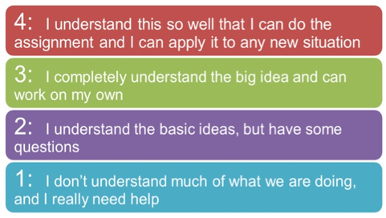
Student Scales in Marzano
These are optional☺
Scales are used with our students to check for their level of understanding of the learning goals

Slide 8
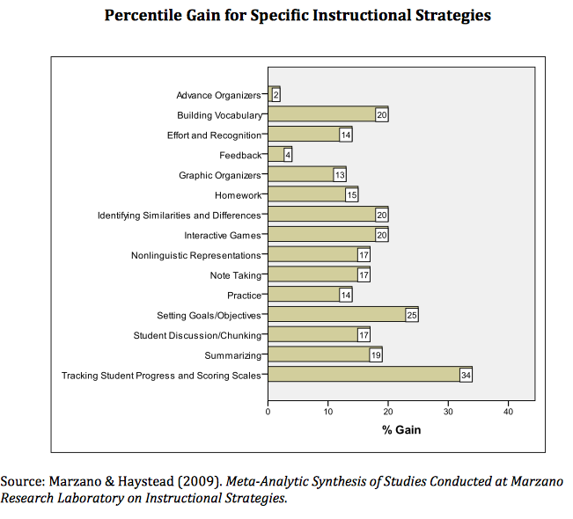

Slide 9
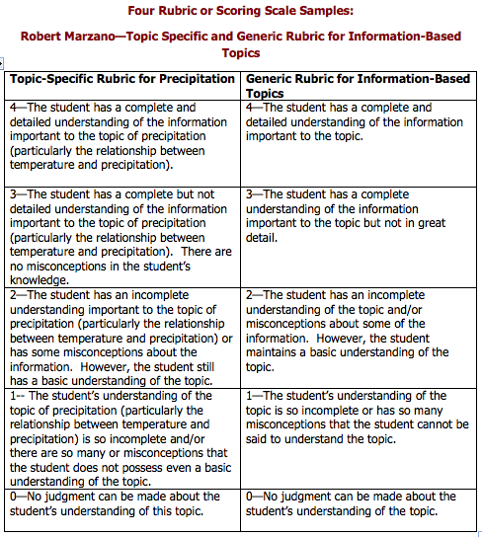

Slide 10
Administrator Co-Observations
All administrators need to have at least one co-observation before and after December 1.
This ensures that administrators are observing and scoring teachers in a similar manner.
The average teacher score in Verona is 3.28 out of 4.

Slide 11
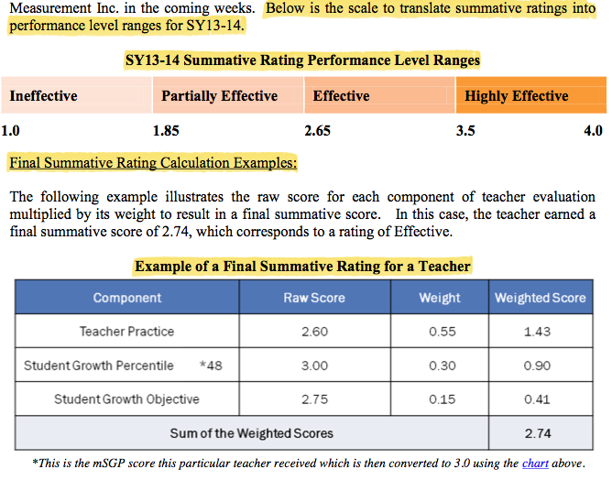
Summative Rating Performance Levels Ranges

Slide 12
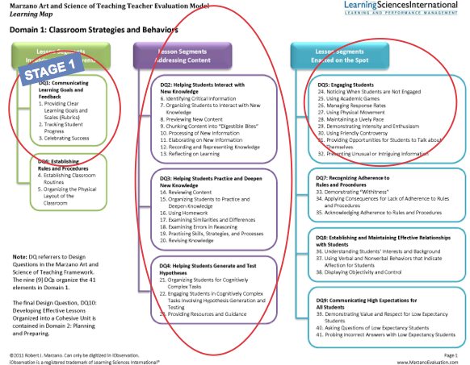
Teacher Component (Domain 1) (70% for non SGP; 55% for SGP teachers)
70%

Slide 13
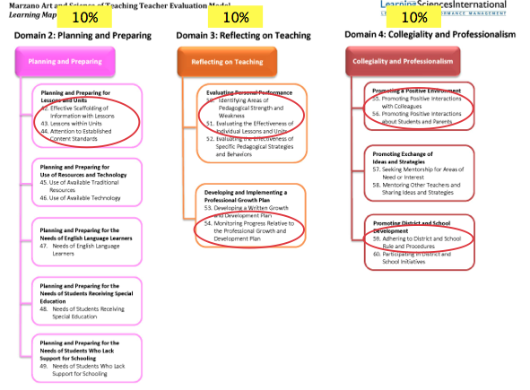
Teacher Component (Domains 2-4)

Slide 14
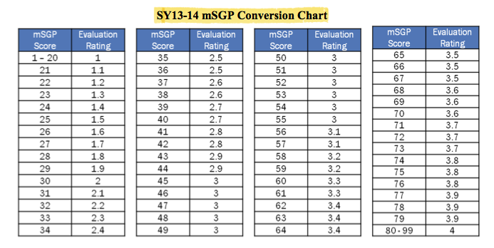
Student Growth Percentiles (30% - Only ELA and Math Teachers Grades 4-8)
30%
http://www.nj.gov/education/AchieveNJ/teacher/percentile.shtml

Slide 15
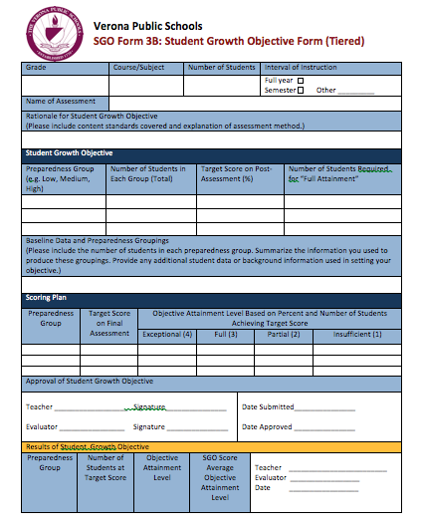
Student Growth Objectives (15% for all teachers)
15%

Slide 18
Professional Development
February 14
Student Growth Objectives
Develop Post-Assessments
Mid-Year Check-In
Adjust Scales (if necessary)
Note: If a scale needs to adjusted:
Please check with supervisor (if you have one)
It needs to be approved by the building principal
Nurses
Work on websites
CST, Special Education Teachers
IEP Revisions, PARCC Accommodations, etc.

Slide 19
Professional Development
February 18
“Do Our Assessments Measure Up?”
Teachers will try the online version of PARCC
www.parcconline.org/computer-based-samples
Go directly to the test items in grades 3-5, grades 6-8 and high school
It has sample ELA and Math questions
Take Online Professional Development
http://www.veronaschools.org/Page/3614
Reading Workshop
Work on UbD Units
Review & Revise Performance Based Tasks/Assessments (Stage 2)
Revise Activities/Lessons (Stage 3)

Slide 20
Professional Development
March 14
Grade Student Growth Objective Post-Assessments (if given)
Review & Reflect on student growth (pre to post)
Enter Data and determine score according to defined scale
Reading Workshop
Work on UbD Units
Any cross-curricular connections?
Review & Revise Performance Based Tasks/Assessments (Stage 2)
Revise Activities/Lessons (Stage 3)

Slide 21
North Essex Professional Development Consortium
PD sessions will focus on one of five strands (see page 2 for additional information on each strand):
Instructional Practices
Special Services
Technology
Health & Wellness
Roundtable Discussions
All PD sessions will run 3:30 PM - 4:30 PM
Spring 2014 NEPDC offerings will run March 10 - May 16
Sessions will be limited to 15 participants
Presenters will be compensated at the contractual rate of their school district per hour. Attendees will receive certificates for PD hours.

Slide 22
North Essex Professional Development Consortium
In order for this new initiative to be successful, we need your input and participation. Consider your knowledge, expertise and talents and how you may be able to share them with colleagues. If you are interested in facilitating an after school PD session, please complete the electronic form via the link below no later than February 18, 2014:
Spring 2014 PD Presenter Interest Form
We will review all submissions and contact all instructors by the end of February to finalize a date for the course. Thank you for your time and consideration!

